Slide 1

School of Computing Science and Engineering
Program: B.Tech
Course Code: BCSE3069
Course Name: Computer Graphics
Teacher : M.Arvindhan

Slide 2
School of Computing Science and Engineering Course Code : BTCS2401 Course Name: Computer Graphics
Unit-2: Transformations
Basic transformation, Matrix representations and homogenous coordinates, Composite transformations, Reflections and shearing. Windowing and Clipping: Viewing pipeline, Viewing transformations, 2-D Clipping algorithms-Line clipping algorithms such as Cohen Sutherland line clipping algorithm, Liang Barskyalgorithm, Line clipping against non rectangular clip windows; Polygon clipping – SutherlandHodgeman polygon clipping, Weiler and Atherton polygon clipping, Curve clipping, Text clipping.
Name of the Faculty: Ravi Sharma Program:B.Tech

Slide 3
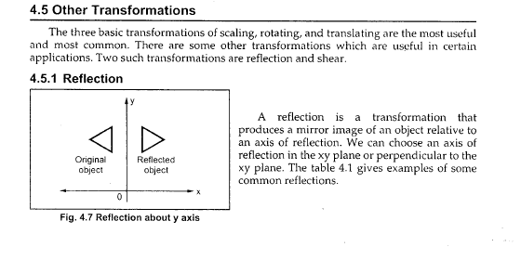
School of Computing Science and Engineering Course Code : BTCS2401 Course Name: Computer Graphics
Name of the Faculty: Ravi Sharma Program:B.Tech

Slide 4
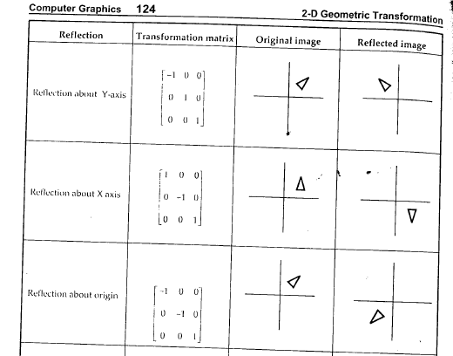
School of Computing Science and Engineering Course Code : BTCS2401 Course Name: Computer Graphics
Name of the Faculty: Ravi Sharma Program:B.Tech

Slide 5
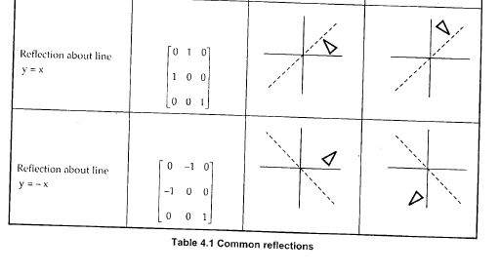
School of Computing Science and Engineering Course Code : BTCS2401 Course Name: Computer Graphics
Name of the Faculty: Ravi Sharma Program:B.Tech

Slide 6
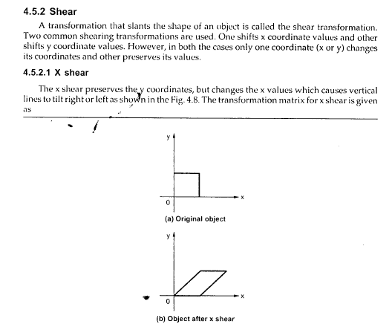
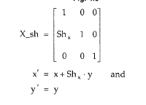
School of Computing Science and Engineering Course Code : BTCS2401 Course Name: Computer Graphics
Name of the Faculty: Ravi Sharma Program:B.Tech

Slide 7

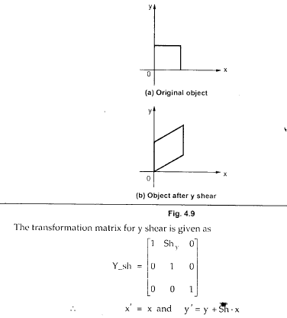
School of Computing Science and Engineering Course Code : BTCS2401 Course Name: Computer Graphics
Name of the Faculty: Ravi Sharma Program:B.Tech

Slide 8
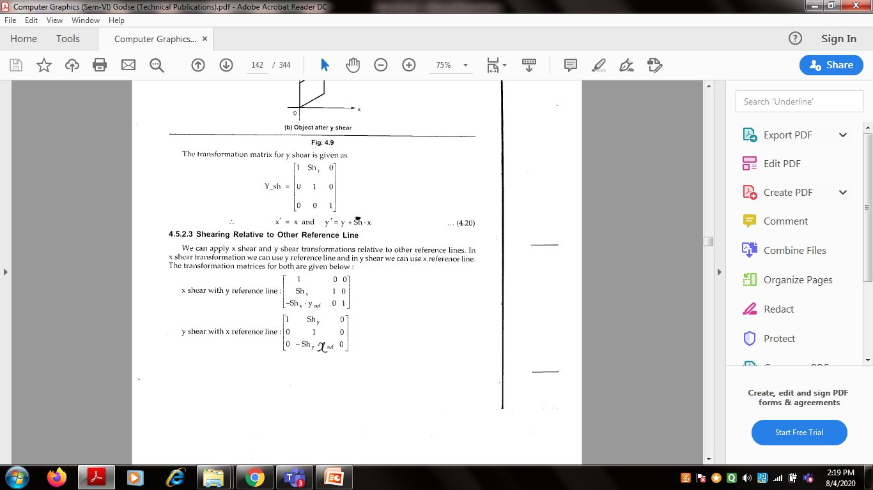
School of Computing Science and Engineering Course Code : BTCS2401 Course Name: Computer Graphics
Name of the Faculty: Ravi Sharma Program:B.Tech

Slide 9
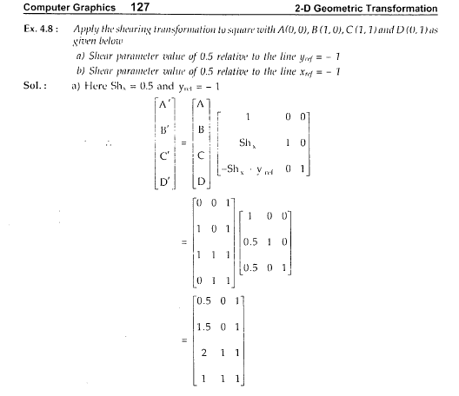
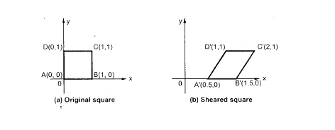
School of Computing Science and Engineering Course Code : BTCS2401 Course Name: Computer Graphics
Name of the Faculty: Ravi Sharma Program:B.Tech

Slide 10
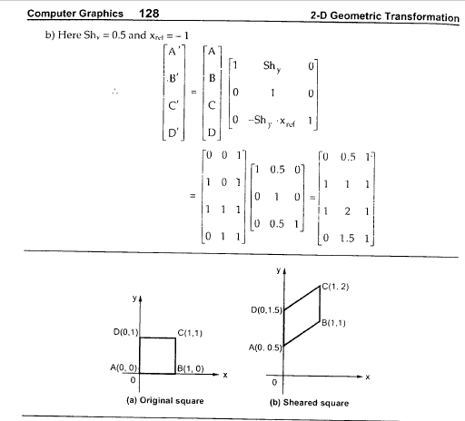
School of Computing Science and Engineering Course Code : BTCS2401 Course Name: Computer Graphics
Name of the Faculty: Ravi Sharma Program:B.Tech

Slide 11
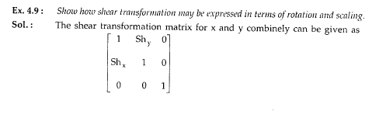
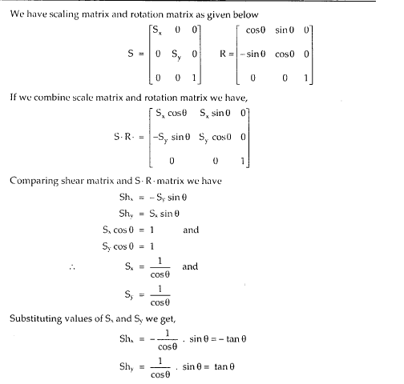
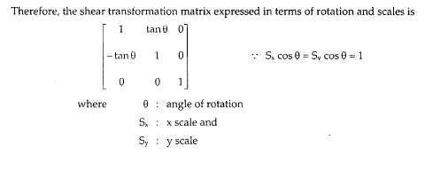
School of Computing Science and Engineering Course Code : BTCS2401 Course Name: Computer Graphics
Name of the Faculty: Ravi Sharma Program:B.Tech

Slide 12


